Slide 1

UNIVERSITY MANAGEMENT SYSTEM
SUBMITTED TO- Dr. Santosh Singh Rathore
Name – VIVEK UPADHYAY ROLL NO – 2021BCS-071
Name – HARSH JHA ROLL NO – 2021BCS-078
Name – ANUPAM KUMAR ROLL NO – 2021BCS-015

Slide 2
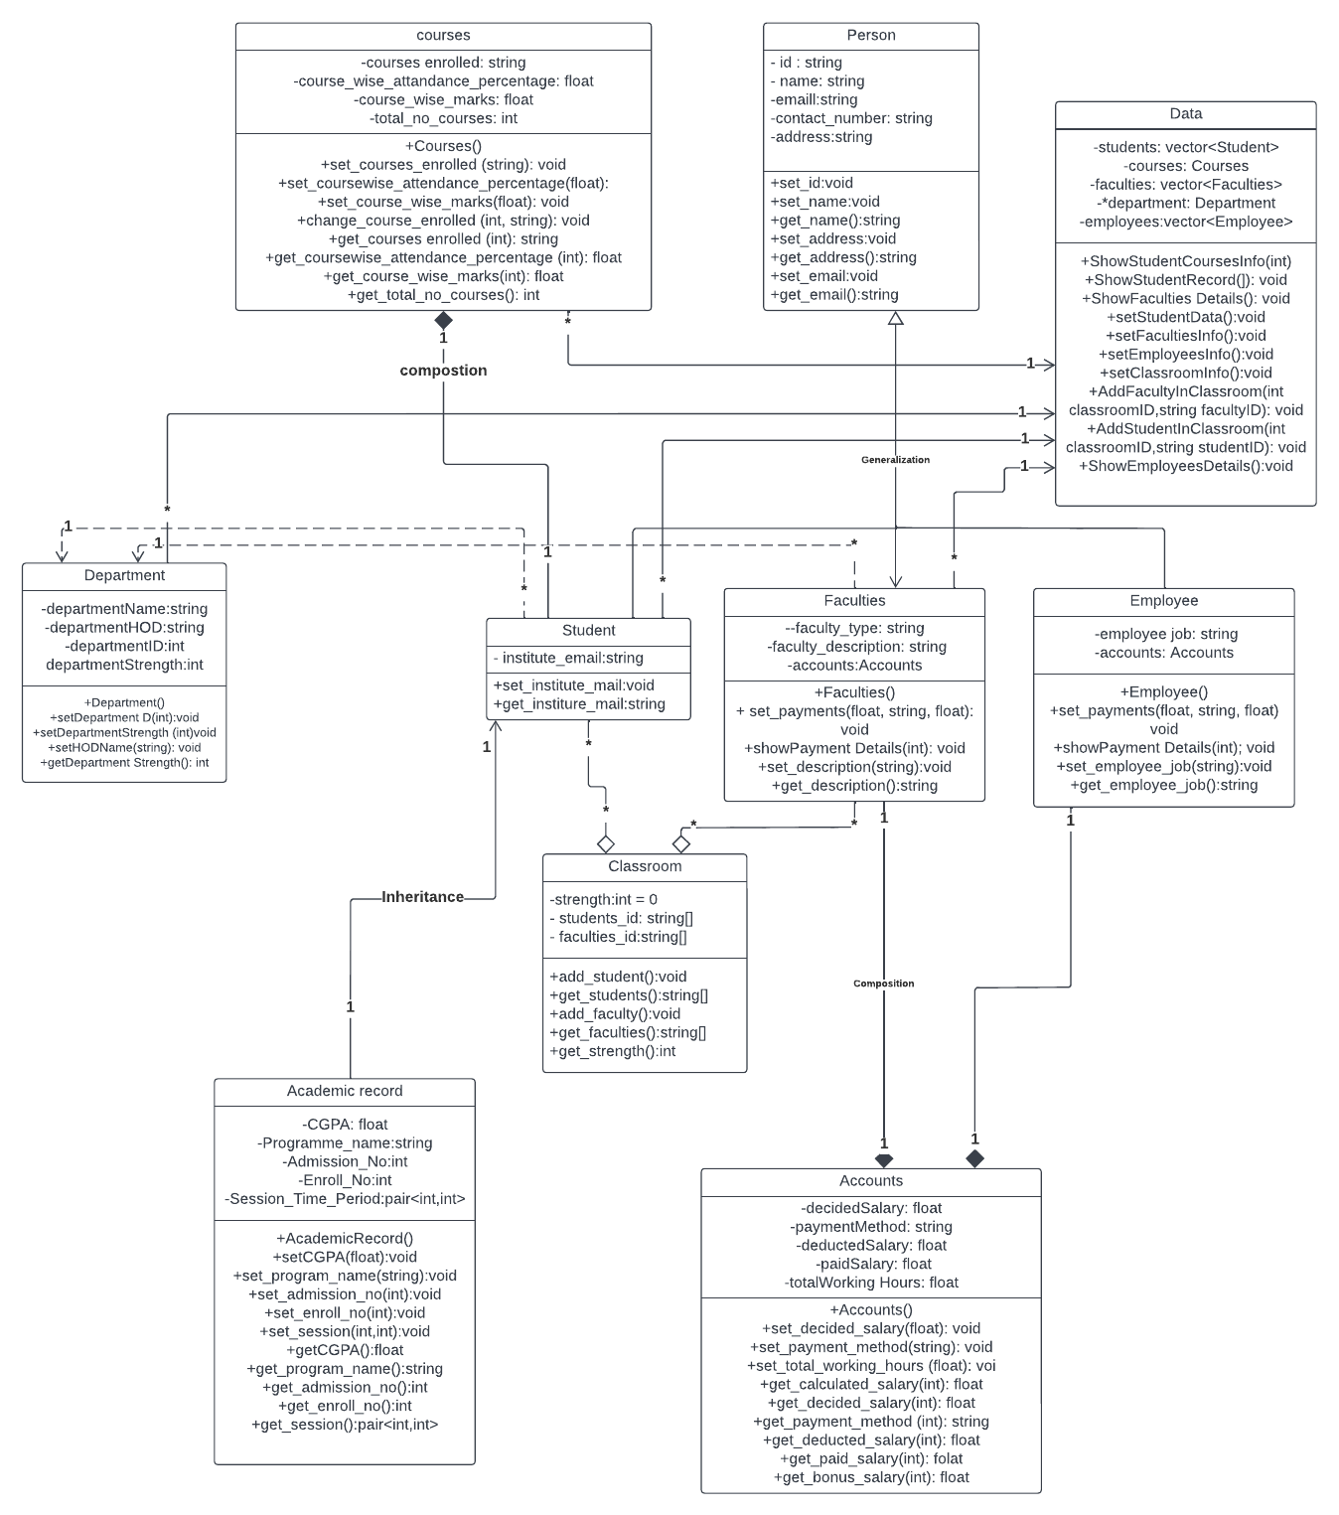
UML CLASS DIAGRAM:-

Slide 3
Explanation:-
We are building a University Management System, in which we have functionalities for:-
1.Add a new student in the university
2.Show the details of all students
3.Show the Academic Record of all students
4.Show the Courses opted by a particular student
5.Add a new faculty in the university
6.Show the details of all faculties in university
7.Show the details of accounts of all faculties
8.Add a new employee in the university
9.Show the details of all employees in university
10.Show the details of accounts of a particular employee
12.Show all the department in the university.
13.Add a new classroom in the university
14.Add a new student in a classroom.
15.Add a new faculty in a classroom.
16.Show all the classrooms in the university.

Slide 4
For this we have a :-
1. Person class:-
Person class is in Person.h header file.
This is a parent class to Student, Faculties and Employees class as every person has the common characteristics and actions of a Person instance.
Data Members are:-
- id : string
- name: string
-emaill:string
-contact_number: string
-address:string
All these data members are in private scope.
Member functions are the usual setters and getters for these data members in public scope.
There is a Generalization from Student,Faculties and Employees to Person class.
2.Department:-
Department class is in Department.h header file.
Department class has a dependency to Student and Faculties class, there can’t exist a Department with 0 student or 0 Faculty in it.
Department hence is a abstract class in this sense.
Data Members are:-
string departmentName;
string departmentHOD;
string departmentID; //ID of the department
int departmentStrength;
All data members are in private scope.

Slide 5
3. Academic Record:-
AcademicRecord is being inherited by Student class.
Every student has a unique Academic Record, no Academic Record can be same of two different students
Data Members are:-
string programme_name; //Like B.TECH CSE
int admission_no;
int enroll_no;
pair<int,int> session_time_period; //duration of program like (2020-2024)
float CGPA;
int total_credits;
4. Courses :-
Courses contain the information regarding the courses picked by a unique student in the university
5. Student:-
Student class is in Student.h header file.
The parent class of Student class are Academic Record,Person and Department.
Student class has a composition to Courses class, as every student has some select courses opted by him.
The Addition Data Member:-
Institute_Mail: string
A :Course class
6. Accounts
Accounts is in Accounts.h header file.
Accounts contain all infomation regarding salary,payment method for a employee/faculty of the University.
Data Members:-
float decidedSalary;
string paymentMethod;
float deductedSalary;
float bonusSalary;
float paidSalary;//to be calculated from other data members
float totalWorkingHours;

Slide 6
7. Faculties:-
Faculties class is for storing all the characteristics and functionalities regarding various function managing faculties in a university.
Faculties has a composition to Accounts, as every has unique account details associated to them.
Data Members:-
string faculty_type;
string faculty_description;
Accounts accounts;
All data members are in private scope.
8. Employee
Employee class is for storing all the characteristics and functionalities regarding various function managing employees in a university.
Employee has a composition to Accounts, as every has unique account details associated to them.
Data Members:-
string employee_job;
Accounts accounts;
All data members are in private scope.
9. Classroom
This class contains information of a unique class in the university
Data Members:-
int strength; //total num of students
vector<string> students_id; //list of ID of students in the class
vector<string> faculties_id;//list of ID of faculties in the class
int classroom_id; //used as unique identifier for a classroom
These data members are in private scope.
10. Display
This is the central class for our management system, which contains most of the functionality for University Management System.
Data Members:-
vector<Student> students;
Courses courses; //this data members is extra
vector<Faculties> faculties;
vector<Employee> employees;
vector<Classroom> classrooms;
Above data members are in private scope.
int total_students = 0;
int total_faculties = 0;
These data members are in public scope.

Slide 7
The member functions are:-
//setter
void setStudentData();
void setStudentAcademicRecord(Student *temp,int counter, string program_name, int admission_no, int enroll_no,
int begin_year, int end_year, float CGPA, int credits);
void setFacultiesInfo();
void setEmployeesInfo();
void setClassroomInfo();
//getter
//showd the record of all students
void ShowStudentsRecord();
void ShowStudentCoursesInfo(int n); //n is the index number
void ShowStudentsAcademicRecord();
void ShowFacultiesDetails();//view the details of the all faculties except account detail
void ShowFacultiesAccountDetails();//view the account details of all faculties
void ShowEmployeesDetails();
void ShowEmployeesAccountDetails();
void ShowClassroomDetails(); //view the details of all classrooms
void AddStudentInClassroom(int classroomID,string studentID);
void AddFacultyInClassroom(int classroomID,string facltyID);
NOTE:-Every class has its own explicity defined default constructor.

Slide 8
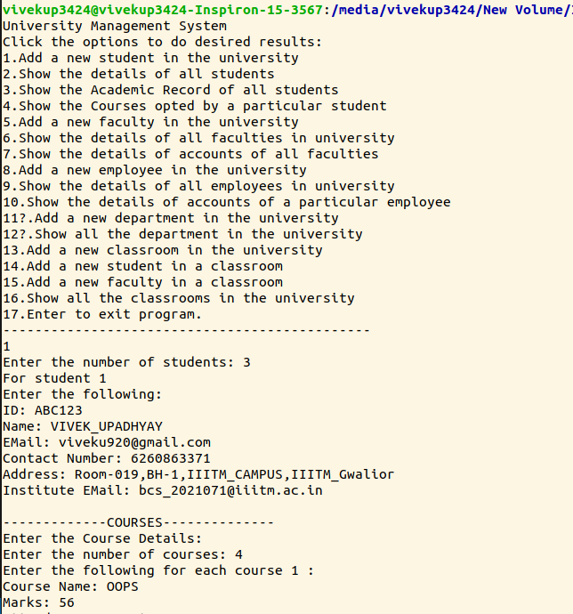
Output:-

Slide 9
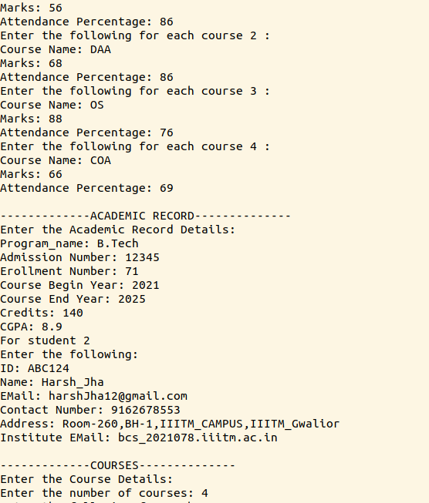
Output:-

Slide 10
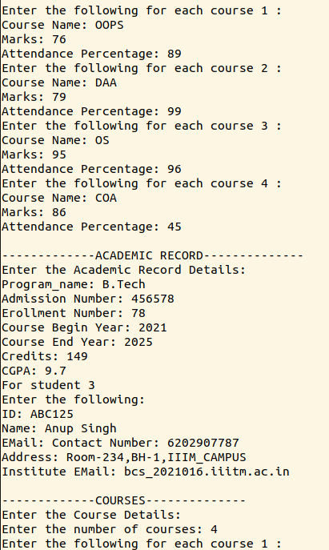
Output:-

Slide 11
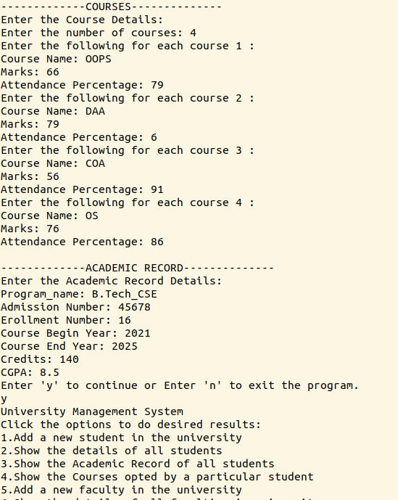
Output:-

Slide 12
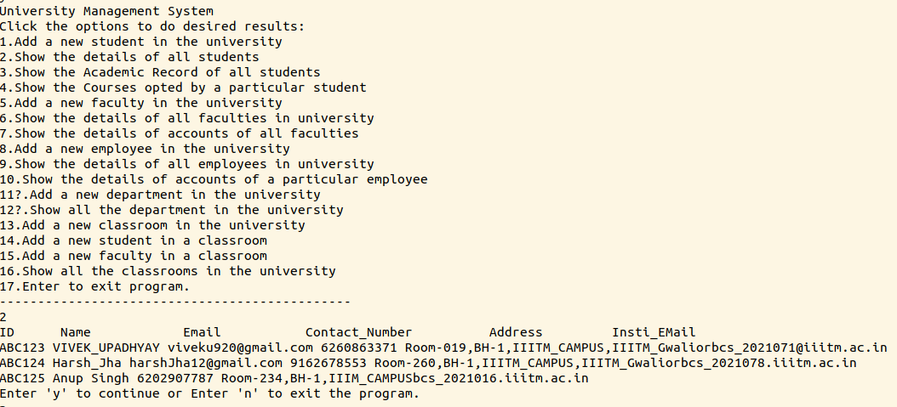
Output:-

Slide 13
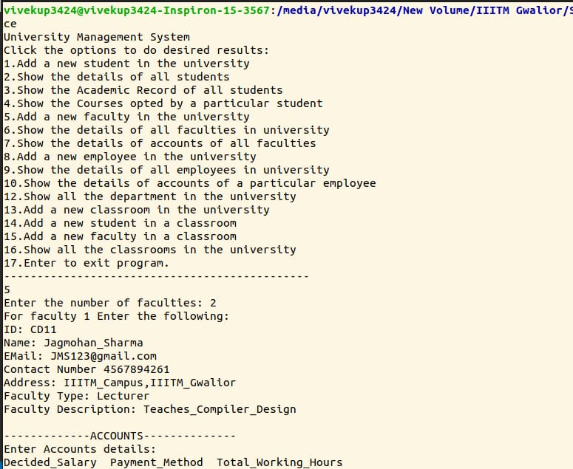
Output:-

Slide 14
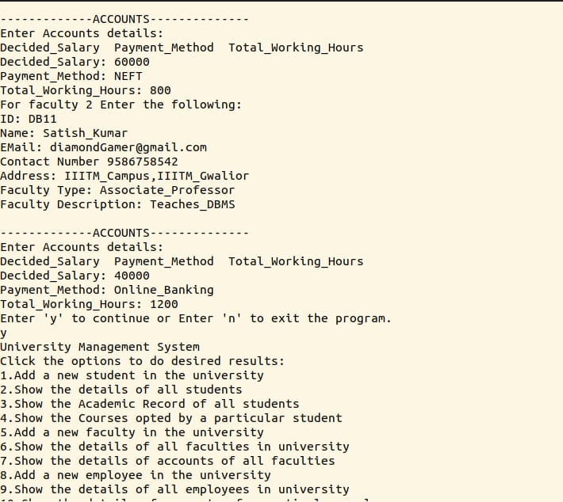
Output:-

Slide 15
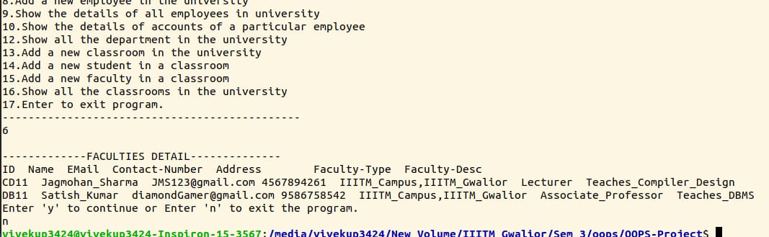
Output:-

Slide 16
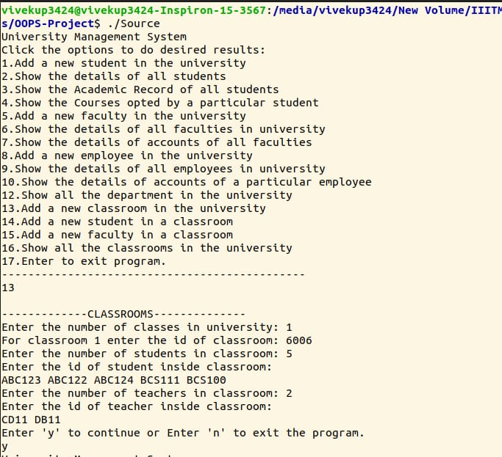
Output:-

Slide 17
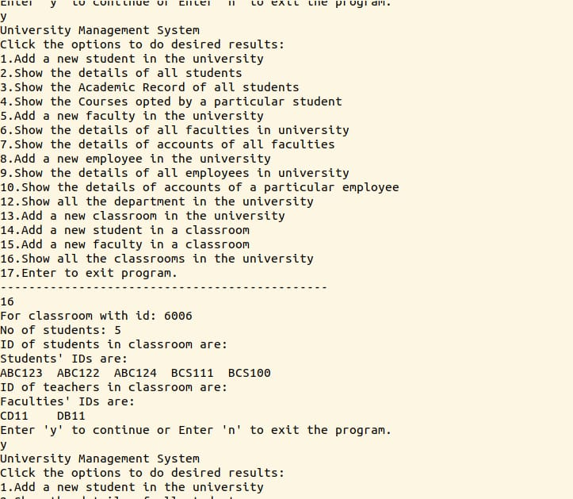
Output:-

Slide 18
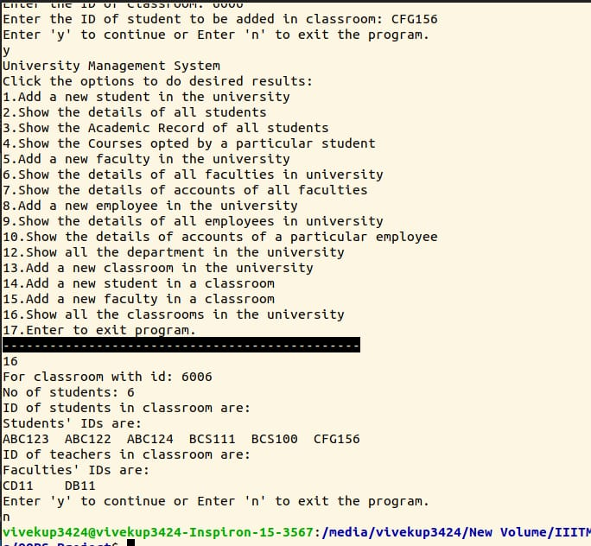
Output:-

